Slide 1

BANGALORE INSTITUTE OF TECHNOLOGY DEPARTMENT OF COMPUTER SCIENCE AND ENGINEERING
DEPARTMENT OF COMPUTER SCIENCE AND ENGINEERING
INTERSHIP PRESENTATION ON
“LAPTOP SELCTION AND PRICE PREDICTTION”
Under the guidance of :
Ms. Farheen Farhath
_{Project Lead}
PRESENTED BY:
SRINIVAS BHARADWAJ K
1BI22MC101

Slide 2
ABSTRACT
In today's digital age, laptops have become an essential tool for work, education, and entertainment. With so many options available on the market, it can be challenging to choose the right laptop for your needs. The dataset provides detailed information on 1000 laptops available on Flipkart, including technical specifications, customer reviews and ratings, and prices. With this comprehensive dataset, the project aims to predict the price of the laptop based on the requirement by implementing Regression, Decision Tree, Random Forest, SVM models and compare the models.

Slide 3
CONTENTS
Introduction
Problem Statement
Objective
Dataset
Libraries Used
Implementation (Code)
Outcome of the Project
Conclusion

Slide 4
INTRODUCTION
Laptop selection and price prediction especially when the laptop is coming direct from the factory to Electronic Market/ Stores, is both a critical and important task.
The mad rush that we saw in 2020 for laptops to support remote work and learning is no longer there. In India, demand of Laptops soared after the Nationwide lockdown, leading to 4.1-Million-unit shipments in the June quarter of 2021, the highest in the five years.

Slide 5
Accurate Laptop price prediction involves expert knowledge, because price usually depends on many distinctive features and factors. Typically, most significant ones are brand and model, RAM, ROM, GPU, CPU, etc. In this project, different methods and techniques are applied in order to achieve higher precision of the used laptop price prediction.

Slide 6
PROBLEM STATEMENT
In today's digital age, laptops have become an essential tool for work, education, and entertainment. With so many options available on the market, it can be challenging to choose the right laptop for your needs. The models predict the price of the laptop based on the requirement and the best model is selected based on the root mean square error and r2score.

Slide 7
OBJECTIVES
To predict the price of the laptop.
An approach to receive higher accuracy.
To build a machine learning model to classify the given problem statement.

Slide 8
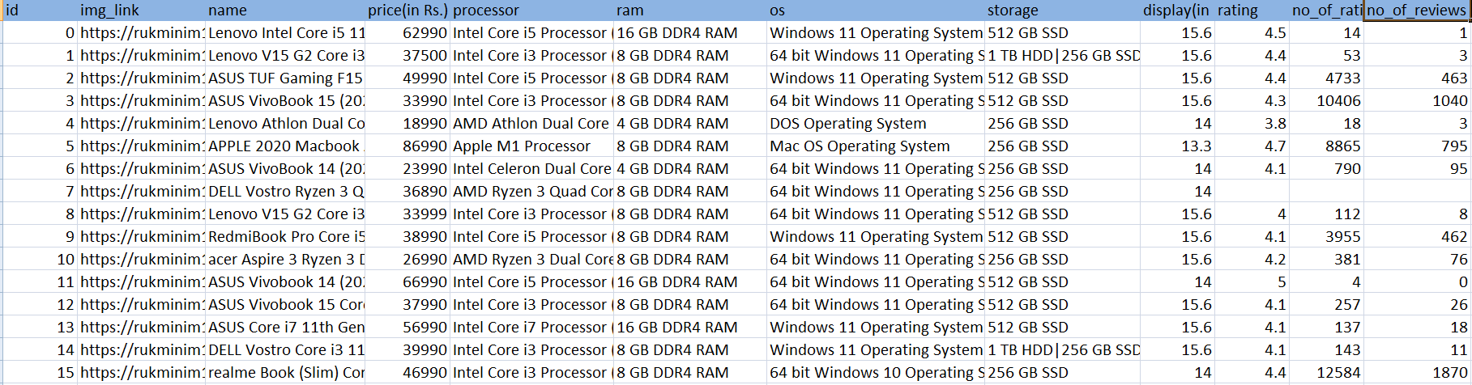
DATASET

Slide 9
LIBRARIES
NumPy (for Numerical Analysis)
Pandas (for handling data files)
Matplotlib(for data visualization)
Seaborn(for data visualization)

Slide 10
IMPLEMENTATION
import pandas as pd
import numpy as np
import matplotlib.pyplot as plt
import seaborn as sns
from sklearn.model_selection import train_test_split
from sklearn.preprocessing import StandardScaler
from sklearn.tree import DecisionTreeRegressor
from sklearn.ensemble import RandomForestRegressor
from sklearn.svm import SVR
from sklearn.metrics import mean_squared_error,r2_score
data=pd.read_csv('laptops.csv')
data.head()
data.shape
data.info()
data.describe()

Slide 11
#Preprocessing #ram data['ramType'] = data.ram.str.split().apply(lambda x : ' '.join(x[2:-1])) data.drop('ram',axis=1,inplace=True) #storage data = data[data["storage"].str.contains("PCI-e SSD (NVMe) ready,Silver-Lining Print Keyboard,Matrix Display (Extend),Cooler Boost 5,Hi-Res Audio,Nahimic 3,144Hz Panel,Thin Bezel,RGB Gaming Keyboard,Speaker Tuning Engine,MSI Center", regex=False) == False] data = data[data["storage"].str.contains("PCI-e Gen4 SSD?SHIFT?Matrix Display (Extend)?Cooler Boost 3?Thunderbolt 4?Finger Print Security?True Color 2.0?Hi-Res Audio?Nahimic 3? 4-Sided Thin bezel?MSI Center?Silky Smooth Touchpad?Military-Grade Durability", regex=False) == False] data["storage"] = data["storage"].str.replace(' GB', '') data["storage"] = data["storage"].str.replace(' TB', '000') new = data["storage"].str.split("|", n = 1, expand = True) data["first"]= new[0] data["first"]=data["first"].str.strip() data["second"]= new[1] data["Layer1HDD"] = data["first"].apply(lambda x: 1 if "HDD" in x else 0) data["Layer1SSD"] = data["first"].apply(lambda x: 1 if "SSD" in x else 0)

Slide 12
data['first'] = data['first'].str.replace(r'\D', '',regex=True) data["second"].fillna("0", inplace = True) data["Layer2HDD"] = data["second"].apply(lambda x: 1 if "HDD" in x else 0) data["Layer2SSD"] = data["second"].apply(lambda x: 1 if "SSD" in x else 0) data['second'] = data['second'].str.replace(r'\D', '',regex=True) data["first"] = data["first"].astype(int) data["second"] = data["second"].astype(int) data["HDD"]=(data["first"]*data["Layer1HDD"]+data["second"]*data["Layer2HDD"]) data["SSD"]=(data["first"]*data["Layer1SSD"]+data["second"]*data["Layer2SSD"]) data.drop(columns=['first', 'second', 'Layer1HDD', 'Layer1SSD','Layer2HDD', 'Layer2SSD'], inplace=True) data.drop('storage',axis=1,inplace=True) # encoding the categorical features using onehot encoding dummies = pd.get_dummies(data.operating_system)dummies data = pd.concat([data,dummies],axis=1) data.drop('operating_system',axis=1,inplace=True) dummies = pd.get_dummies(data.brand) data = pd.concat([data,dummies],axis=1) data.drop('brand',axis=1,inplace=True) data.head() dummies = pd.get_dummies(data.ramType) data = pd.concat([data,dummies],axis=1)

Slide 13
data.drop('ramType',axis=1,inplace=True) data.processor.value_counts() data['cpu'] = data['processor'].apply(lambda x:" ".join(x.split()[0:3])) data.cpu.value_counts() dummies = pd.get_dummies(data.cpu) data = pd.concat([data,dummies],axis=1) data.drop('processor',axis=1,inplace=True) data.drop('cpu',axis=1,inplace=True) #splitting dataset into train and test datasets x_train,x_test,y_train,y_test = train_test_split(x,y,test_size=0.20) len(x_train),len(y_train),len(x_test),len(y_test) #standardizing data x_sc = StandardScaler() y_sc = StandardScaler() y__train = y_train.reshape(len(y_train),1) y__test = y_test.reshape(len(y_test), 1) x__train = x_sc.fit_transform(x_train) y__train = y_sc.fit_transform(y__train) x__test = x_sc.transform(x_test)y _test = y_sc.transform(y__test)

Slide 14
#decision tree dreg = DecisionTreeRegressor() dreg.fit(x__train,y__train.reshape(len(y__train))) dtpred = dreg.predict(x__test) #random forest rreg = RandomForestRegressor(n_estimators=10) rreg.fit(x__train,y__train.reshape(len(y__train))) rfpred = rreg.predict(x__test) #svr sreg = SVR(kernel='linear') sreg.fit(x__train,y__train.reshape(len(y__train))) srpred = sreg.predict(x__test)

Slide 15
#rsme and r2score #decision tree rsme_dt = np.sqrt(mean_squared_error(y_test,dtpred)) rsdt = r2_score(y_test,dtpred) rsme_dt,rsdt #random forest rsme_rf = np.sqrt(mean_squared_error(y_test,rfpred)) rsrf = r2_score(y_test,rfpred) rsme_rf,rsrf #svr rsme_sr = np.sqrt(mean_squared_error(y_test,srpred)) rssr = r2_score(y_test,srpred) rsme_sr,rssr

Slide 16
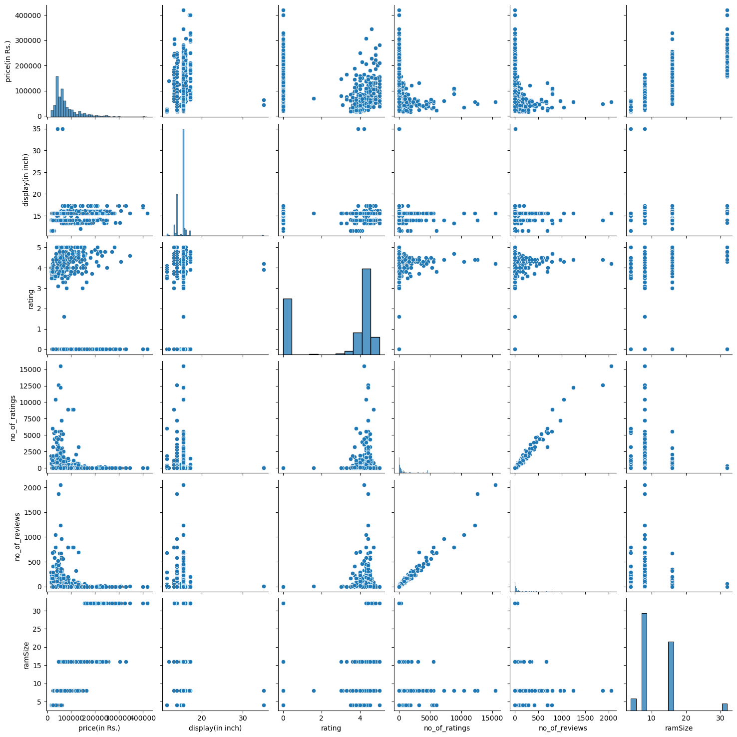
SNAPSHOTS

Slide 17
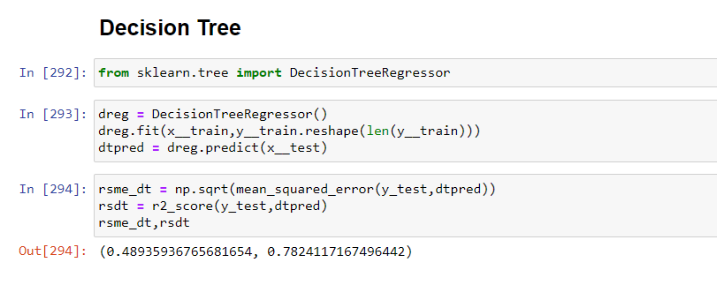

Slide 18
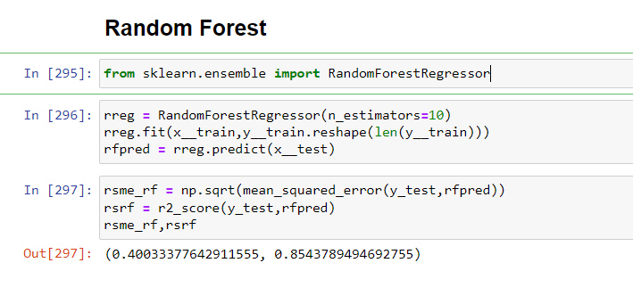

Slide 19
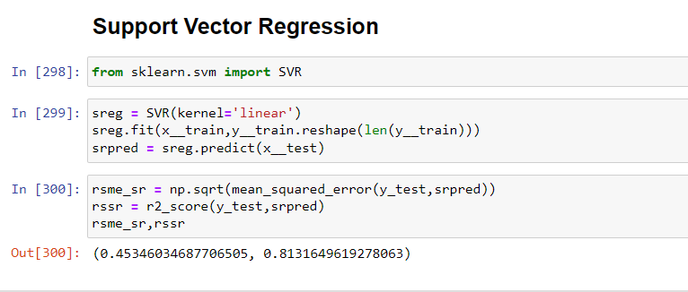

Slide 20
CONCLUSION
I have found the important features which could play a vital role in laptop selection and non influential features as well. I studied the report of prediction carefully. I can expand the existing system with additional analysis methods and implementation with neural networks and deep learning.

Slide 21
THANK YOU

